Slide 1
Advanced Tree Data Structures

Slide 2
Balanced Search Trees
A search-tree data structure for which a height of O(log n) is guaranteed when implementing a dynamic set of n items.
Examples:
AVL trees ( Discussed in Unit-1)
2-4 trees ( This Lecture)
B+-trees
Red-black trees

Slide 3
2-4 Trees
Search Trees (but not binary)
Also known as 2-4, 2-3-4 trees
Very important as basis for Red-Black trees

Slide 4
Multi-way Search Trees
Each internal node of a multi-way search tree T:
has at least two children
stores a collection of items of the form (k, x), where k is a key and x is an element
contains d - 1 items, where d is the number of children
“contains” 2 pseudo-items: k₀ = –∞, k_{d} = ∞
Children of each internal node are “between” items
all keys in the subtree rooted at the child fall between keys of those items
External nodes are just placeholders

Slide 5
Multi-way Searching
Similar to binary searching
If search key s < k₁, search the leftmost child
If s > k _{d – 1}, search the rightmost child
That’s it in a binary tree; what about if d > 2?
Find two keys k_{i – 1} and k_{i} between which s falls, and search the child v_{i}.

Slide 6
Multi-way Searching
Searching
22
for
s
= 8
Searching
5
10
for
s
= 12
25
3
4
6
8
14
23
24
27
11 13
17 18 19 20 21
Not found!

Slide 7
(2,4) Trees
12
At most 4 children
All external nodes have same depth
Height h of (2,4) tree is O(logn).
How is this fact useful in searching?
5
10
15
3
4
6
8
11
13 14
17

Slide 8
(2,4) Insertion
Always maintain depth condition
Add elements only to existing nodes
Empty
Insert 4
4
Insert 6
4
6
tree
Insert 12
4
6
12
Insert 15
?

Slide 9
(2,4) Insertion
What if that makes a node too big?
- overflow
Must perform a split operation
replace node v with two nodes v' and v''
v' gets the first two keys
v'' gets the last key - send the other key up the tree
if v is root, create new root with third key
otherwise just add third key to parent

Slide 10
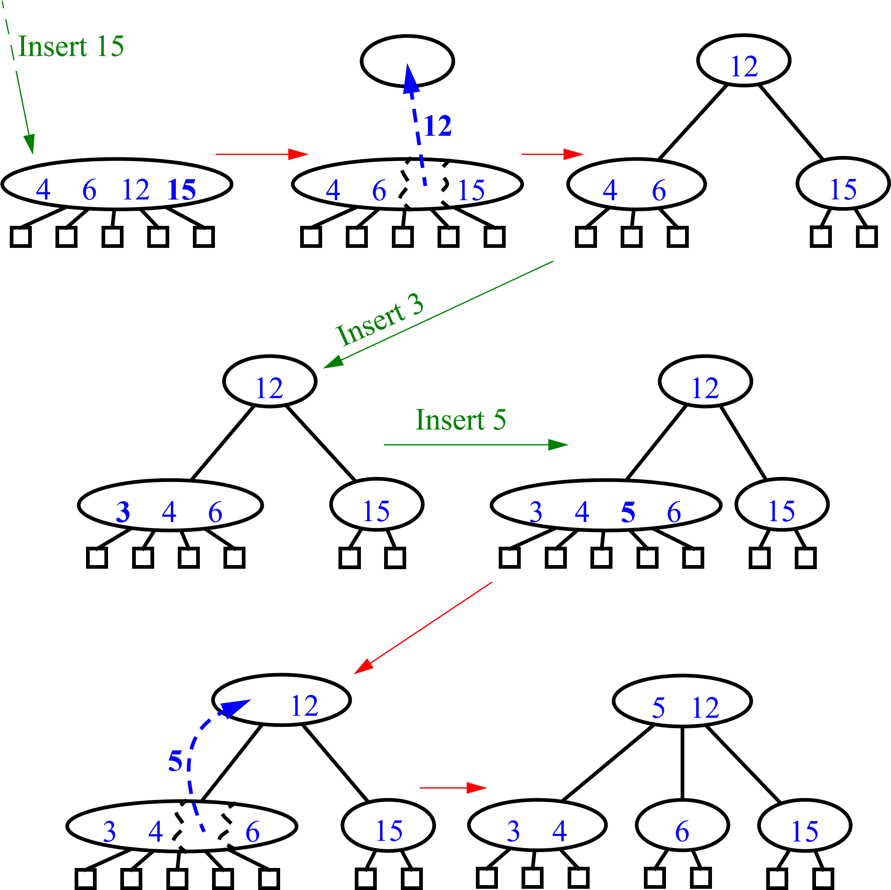
(2,4) Insertion (cont.)

Slide 11
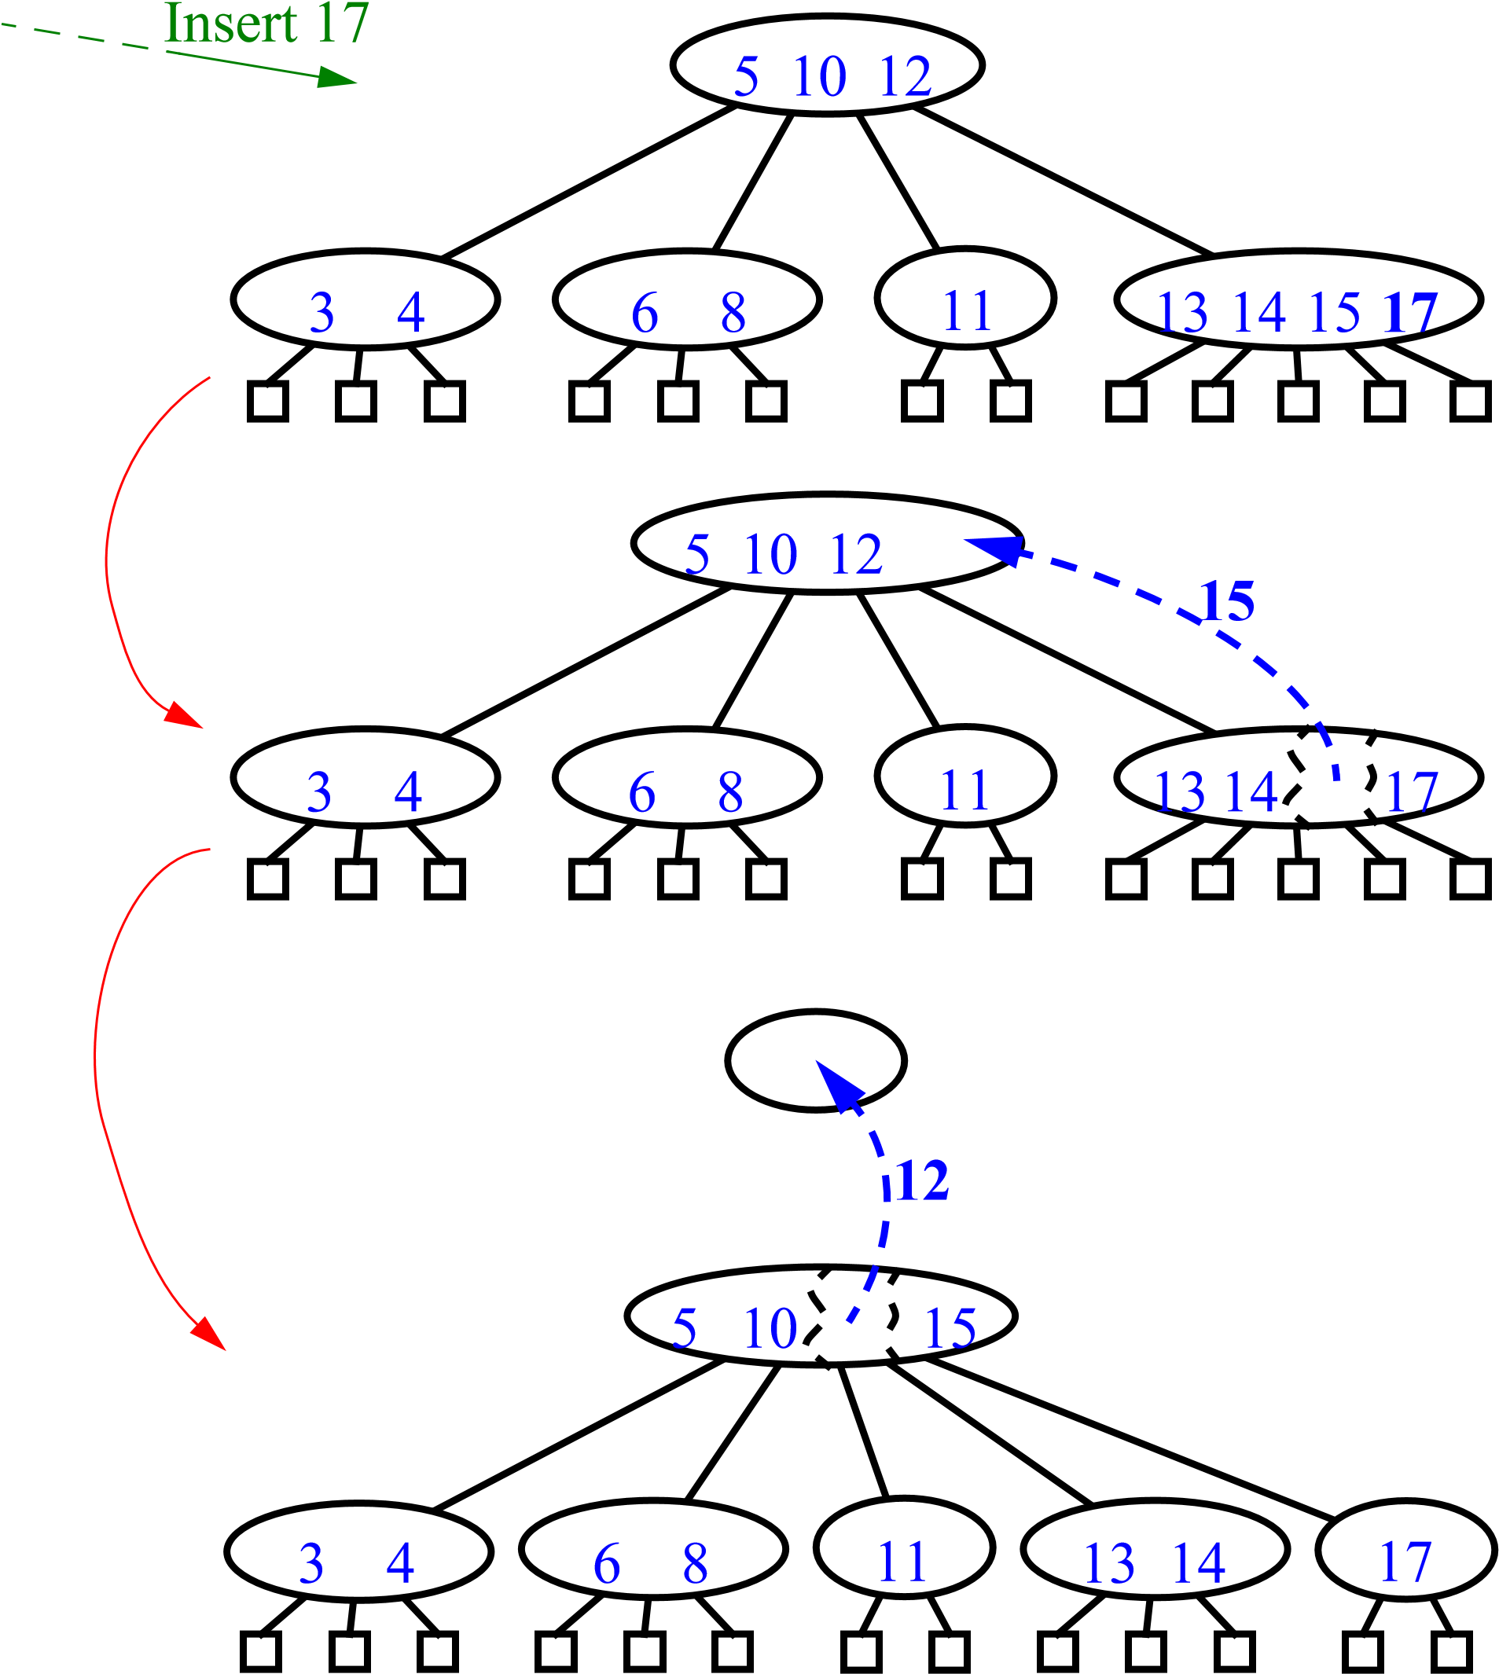
(2,4) Insertion (cont.)
Tree always grows from the top, maintaining balance
What if parent is full?
Do the same thing
Overflow cascade all the way up to the root
still at most O(logn)

Slide 12
Analysis of Insertion
Insert a new item (k, o) at the parent v of the leaf reached by
searching for k
Algorithm put(k, o)
1. We search for key k to locate the insertion node v
2. We add the new entry (k, o) at node v
3. while overflow(v)
if isRoot(v)
create a new empty root above v
v ← split(v)

Slide 13
Analysis of Insertion
Let T be a (2,4) tree with n items
Tree T has O(log n) height
Step 1 takes O(log n) time because we visit O(log n) nodes
Step 2 takes O(1) time
Step 3 takes O(log n) time because each split takes O(1) time and we perform O(log n) splits q
Thus, an insertion in a (2,4) tree takes O(log n) time

Slide 14
(2,4) Deletion
First of all, find the key
simple multi-way search
Then, reduce to the case where item to be deleted is at the bottom of the tree
Find item which precedes it in in-order traversal
Swap them
Remove the item

Slide 15
(2,4) Deletion
Delete 13
11
6
15
13
5
8
10
14
17

Slide 16
(2,4) Deletion
Removing from 2-nodes
Not enough items in the node
underflow
Pull an item from the parent, replace it with an item from a sibling
called transfer

Slide 17
(2,4) Deletion
De
5
10
l
ete 4
4
6
8
11
u
10
5
v
6
w
8
11

Slide 18
(2,4) Deletion
What happens if siblings are 2-nodes?
Could we just pull one item from the parent?
too many children
But maybe...
We know that the node’s sibling is just a 2-node
So we fuse them into one after removing an item from the parent,

Slide 19
(2,4) Deletion
Delete 12
6
10
12
5
8
u
6
10
v
5
8
u
6
5
8
10

Slide 20
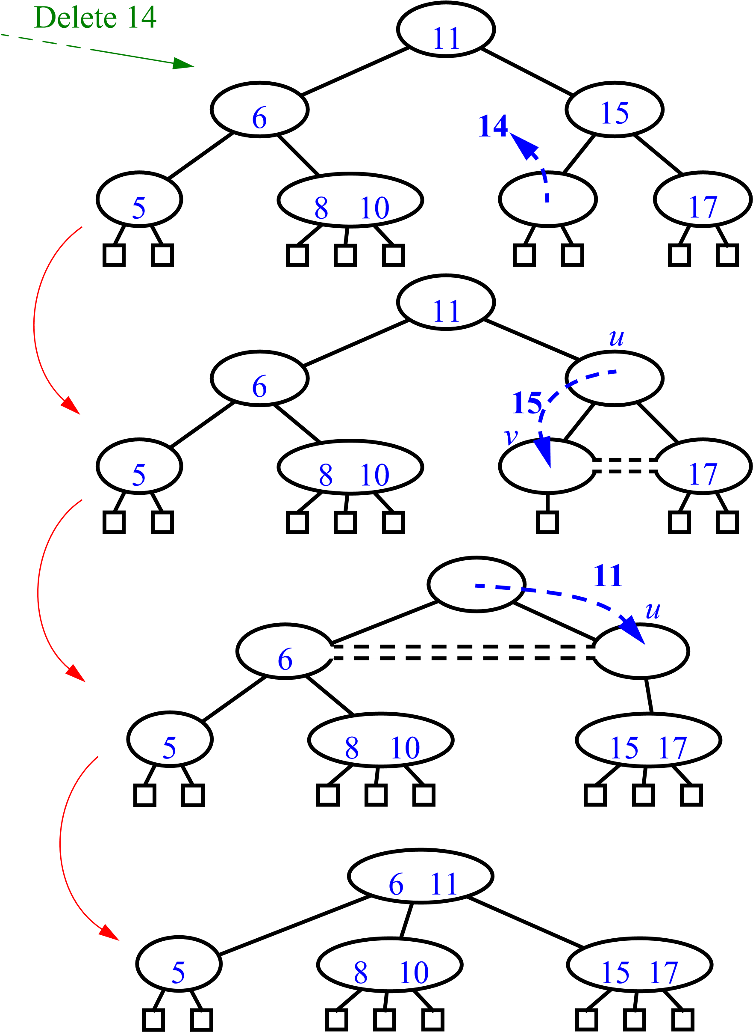
(2,4) Deletion
what if the parent was a2-node?
Underflow can cascade up the tree, too.

Slide 21
Analysis of Deletion
Let T be a (2,4) tree with n items
Tree T has O(log n) height
In a deletion operation
We visit O(log n) nodes to locate the node from which to delete the entry
We handle an underflow with a series of O(log n) fusions, followed by at most one transfer
Each fusion and transfer takes O(1) time
Thus, deleting an item from a (2,4) tree takes
O(log n) time

Slide 22
(2-4) Trees Conclusion
The height of a (2,4) tree is O(logn).
Split, transfer, and fusion each take O(1) .
Search, insertion and deletion each take O(logn).

